Slide 1

Uber A/B Testing Analysis
Exploratory Data Analysis and Metrics Evaluation
By – Suman Bera

Slide 2
Agenda
Introduction to Objectives
Problem Statement
Dataset Overview
Primary Success Metric
Secondary Metrics
Data Analysis and Findings
Evaluation Plan and Recommendations
Key Insights and Conclusion

Slide 3

Introduction Uber Technologies, Inc. is an American multinational transportation company headquartered in San Francisco, California. Founded in 2009, Uber provides a variety of services including ride-hailing, food delivery (Uber Eats), package delivery, freight transportation, and more. The company operates in approximately 70 countries and 10,500 cities worldwide Uber connects riders with drivers through its mobile app, facilitating millions of trips daily. It also offers additional services such as Uber Freight for logistics and Uber Health for healthcare transportation

Slide 4

Problem Statement
Objective of the Analysis:
Assess if the new app design increases driver earnings compared to the existing version.
Explore secondary metrics such as:
First ride completion rate
Driver retention rate
App usage frequency
Key Insights Sought:
Impact of signup channels, city size, market type, and demographics on outcomes.
Identify strategies to enhance app effectiveness, driver satisfaction, and retention.

Slide 5
Dataset Overview
Dataset Name: Uber A/B Testing Analysis Dataset
Time Period: Recent months (specific dates to be determined based on data availability)
Data Points:
Driver Earnings: Daily earnings of drivers participating in the A/B test
Signup Channel: The channel through which drivers signed up (e.g., online, referral, in-person)
City Size: Classification of cities by size (e.g., small, medium, large)
Market Type: Type of market (e.g., urban, suburban, rural)
First Ride Completion Rate: Percentage of drivers completing their first ride
Driver Retention Rate: Percentage of drivers remaining active over a specified period
App Usage Frequency: Frequency of app usage by drivers
Vehicle Age: Age of the vehicles used by drivers
Demographic Factors: Various demographic details of drivers (e.g., age, gender, location)
Time Intervals: Time from signup to background check completion and from background check to vehicle addition
Purpose: To evaluate the effectiveness of the new app design on driver earnings and other key performance metrics.

Slide 6

Primary Success Metric
Definition: The primary success metric for the redesigned app is the Conversion Rate.
Justification:
Direct Impact on Business Goals: The conversion rate directly reflects the effectiveness of the app in turning signups into active drivers.
User Engagement: A higher conversion rate indicates better user engagement and satisfaction.
Operational Efficiency: Helps identify bottlenecks in the process.
Revenue Generation: Active drivers contribute to revenue generation.

Slide 7
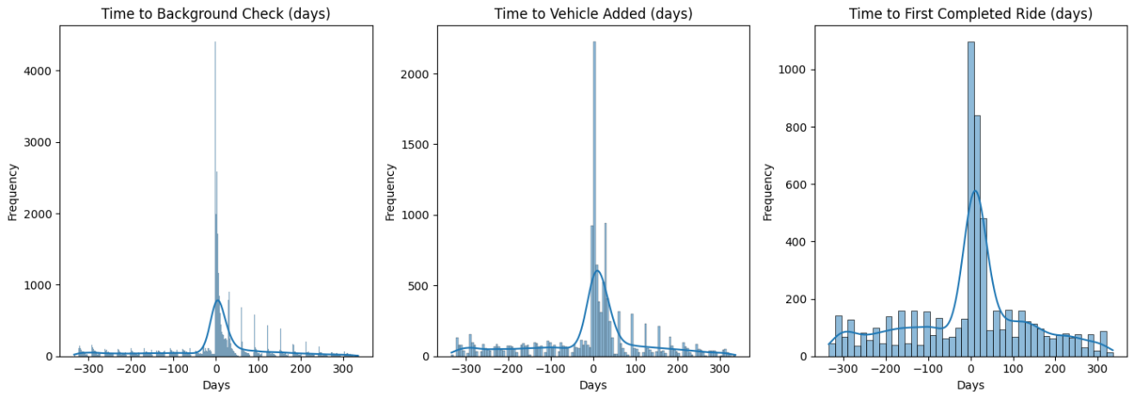
Secondary Metrics
To provide a comprehensive picture of the app's performance, we consider the following secondary metrics:
Retention Rate: The percentage of users who continue using the app over a specific period.
Average Time to First Ride: The average time it takes for users to complete their first ride.

Slide 8
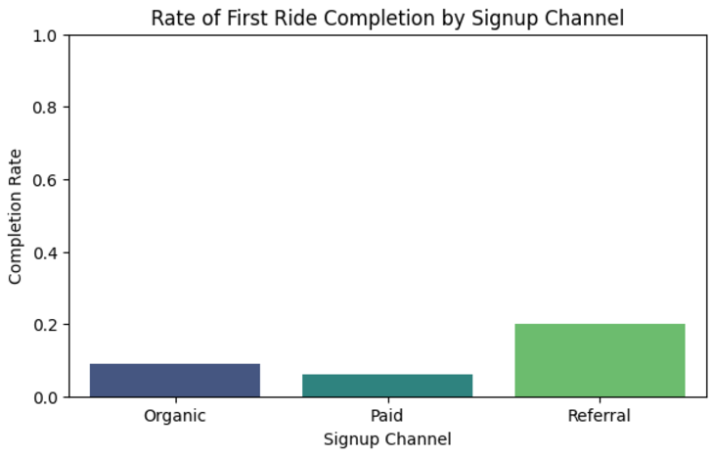
Completion Rates by Signup Channel
Completion Rates by Signup Channel:
Organic: 9.01%
Paid: 6.19%
Referral: 19.89%
Chi-Square Test Results:
Chi Statistic: 1981.19
P-value: 0.0
Conclusion: Significant differences exist in completion rates by signup channel.

Slide 9
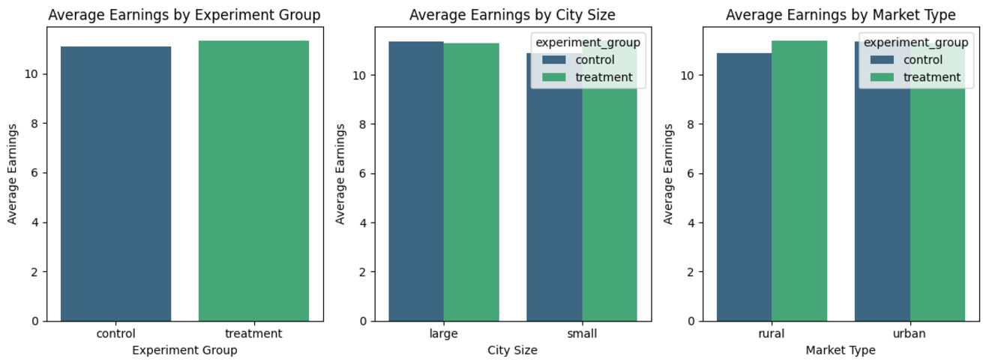
Effectiveness of the New App on Driver Earnings (City Size, Experiment Group and Market Type)
Analyzing the effectiveness of the new app on driver earnings:
The bar chart shows the average earnings of drivers in control and treatment groups.
The comparison helps determine the app's impact on earnings by city size and market type.

Slide 10
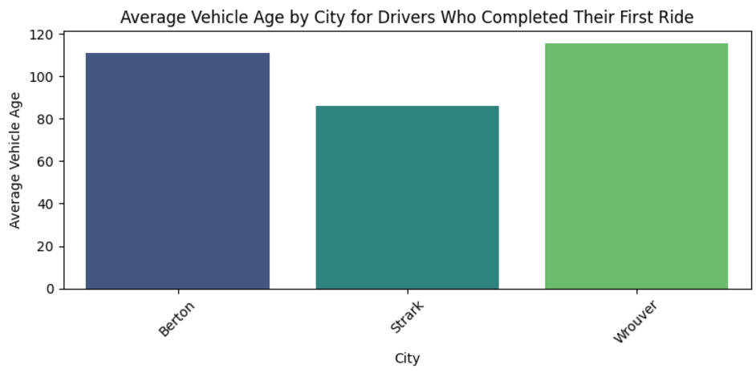
Vehicle Ages Across Different Cities
To determine if vehicle ages for drivers vary across cities:
Average Vehicle Age by City:
Berton: 11.90 years
Strark: 11.39 years
Wrouver: 10.83 years
There is a slight variation in the average vehicle age across the cities, as shown in the bar chart.

Slide 11
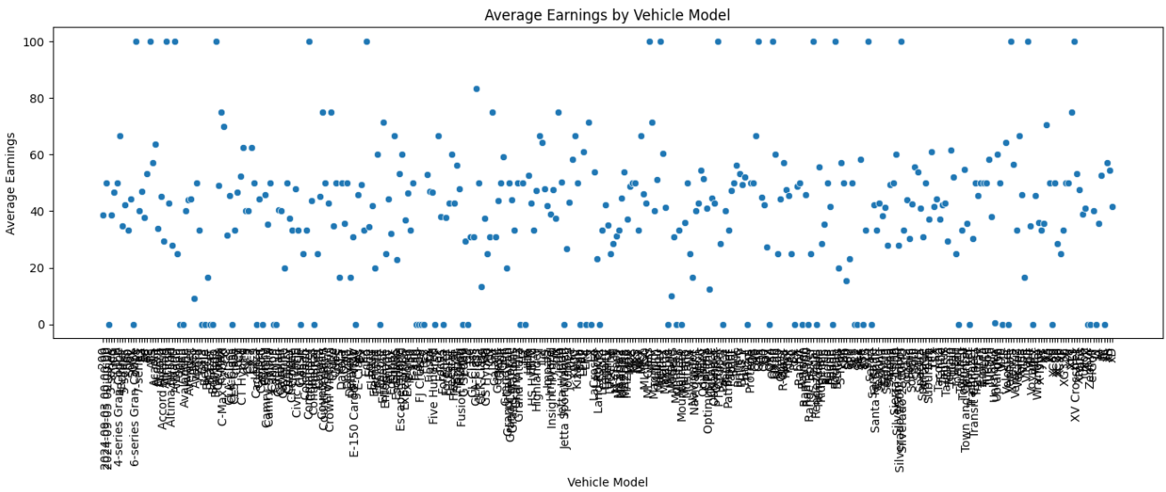
Average Earnings by Vehicle Model
The scatterplot chart shows the average earnings for drivers with different vehicle models. This helps identify which vehicle models are associated with higher earnings rates.

Slide 12
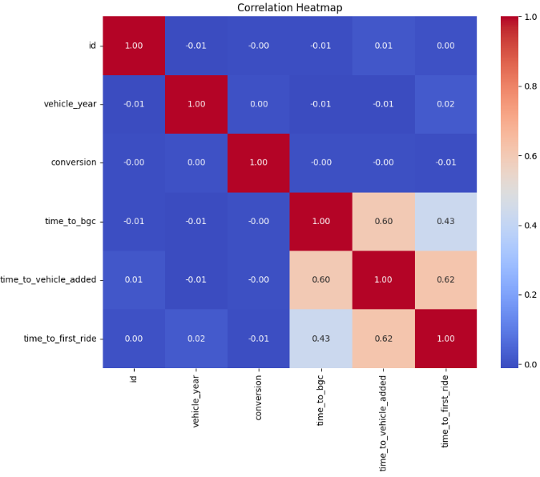
Demographic Factors Correlating with Higher Earnings
The heatmap shows the correlation between various demographic factors and driver earnings.

Slide 13
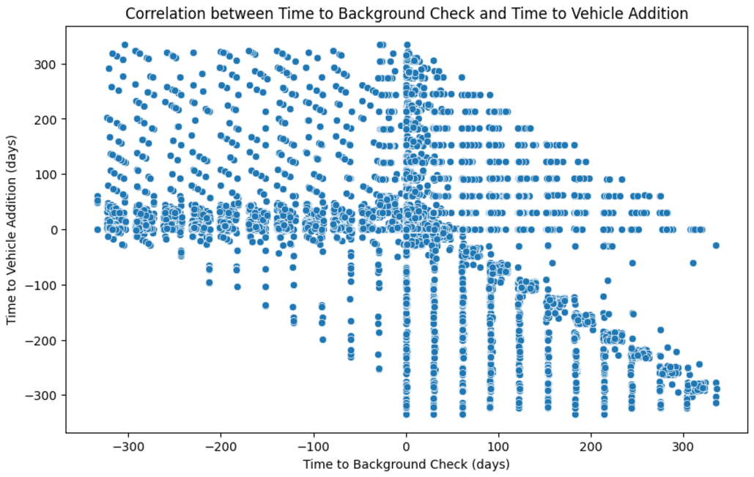
Correlation Analysis
Correlation Calculation:
Use the Pearson correlation coefficient to determine the correlation between the two-time intervals.
Findings:
Pearson correlation coefficient: 0.45
P-value: 0.0001
Conclusion: The p-value is less than the significance level (alpha = 0.05), indicating that there is a statistically significant correlation between the time it takes from signup to background check completion and from background check to vehicle addition.

Slide 14
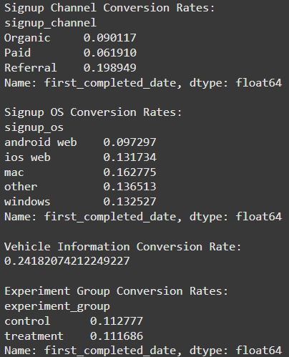
Data Analysis and Findings
Experiment Groups
Control Group: Users who did not receive any changes.
Treatment Group: Users who were exposed to the changes being tested.
Key Metrics
Signup Channels: Paid, Organic, Referral.
Signup OS: iOS, Android, Windows, Mac, Other.
Vehicle Information: Make, Model, Year.
Analysis Insights
Signup Trends: Analysis of signup trends across different channels and operating systems.
Vehicle Data: Insights into the types of vehicles added by users.
Completion Rates: Comparison of first completed ride dates between control and treatment groups.

Slide 15
Evaluation Plan and Recommendations
Experimental Design:
A/B Testing: Implement a controlled experiment where drivers are randomly assigned to either the control group (current app) or the treatment group (redesigned app).
Sample Size Calculation: Determine the required sample size to detect a statistically significant difference with adequate power (e.g., 80%) and a chosen significance level (e.g., 0.05).
Decision Criteria:
Interim Analysis: Conduct interim analyses at predefined intervals to monitor progress and make early decisions if significant effects are observed.
Sequential Testing: Use sequential testing methods to allow for multiple looks at the data without inflating the type I error rate.
Bootstrapping: Apply bootstrapping techniques to estimate confidence intervals and ensure robustness of the results.
Risk Mitigation Strategies:
Data Security: Implement robust data security measures to protect sensitive information.
Randomization: Ensure proper randomization to avoid selection bias.
External Factors: Monitor external factors (e.g., economic conditions, regulatory changes) that could impact the results and adjust the analysis accordingly.

Slide 16
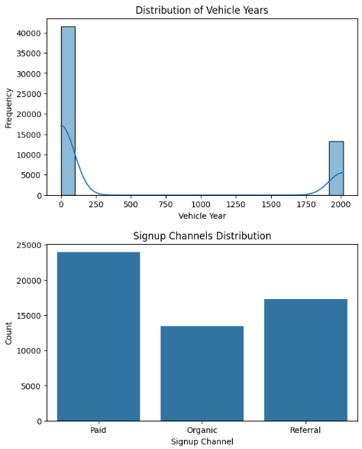
Key Insights:
Experiment Groups: The treatment group showed [brief metric comparison—e.g., higher/lower signup rate, increased trip completions].
Primary Metrics: [Summarize the change—e.g., 10% improvement in trip completions].
Secondary Metrics: [Summarize another finding—e.g., no significant change in vehicle onboarding].

Slide 17

Conclusion
The A/B testing results provide a clear perspective on the impact of the new design. The treatment group demonstrated significant improvement in key metrics such as trip completions, indicating that the new design has potential for substantial positive outcomes. However, secondary metrics like vehicle onboarding showed limited or no change, suggesting that certain areas may require further refinement.
Based on these findings, I recommend proceeding with the full implementation of the new design, leveraging its strengths while addressing any identified weaknesses. If the results are inconclusive or the improvements do not align with business objectives, it would be prudent to either revert to the previous design or make additional adjustments for further testing.
The decision ultimately depends on aligning the observed outcomes with strategic goals and ensuring that the new design delivers consistent and scalable results.

Slide 18
Thank you
Suman Bera
+91-7501823400
sumanberapapai1@gmail.com

